Slide 1
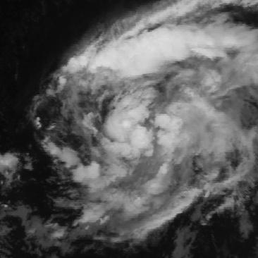
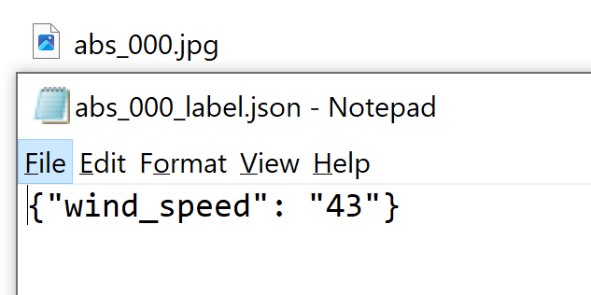
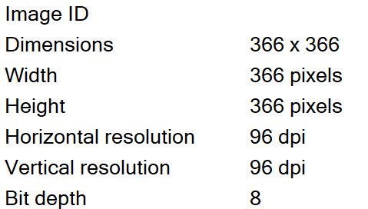
Tropical Cyclone Wind Estimation Competition
Objective:
With a collection of tropical storm images from 2000 to 2019 and corresponding surface wind speed: Estimate the wind speed of similar satellite storm images.
https://beta.source.coop/repositories/nasa/tropical-storm-competition/download/

Slide 2
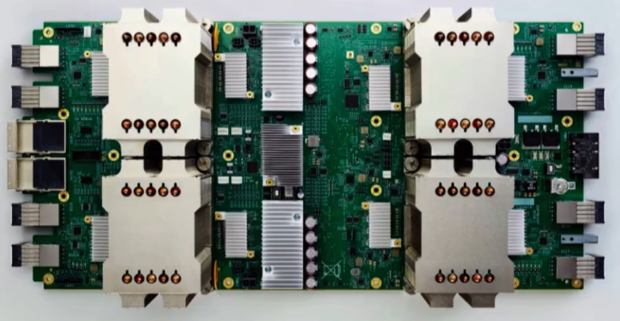
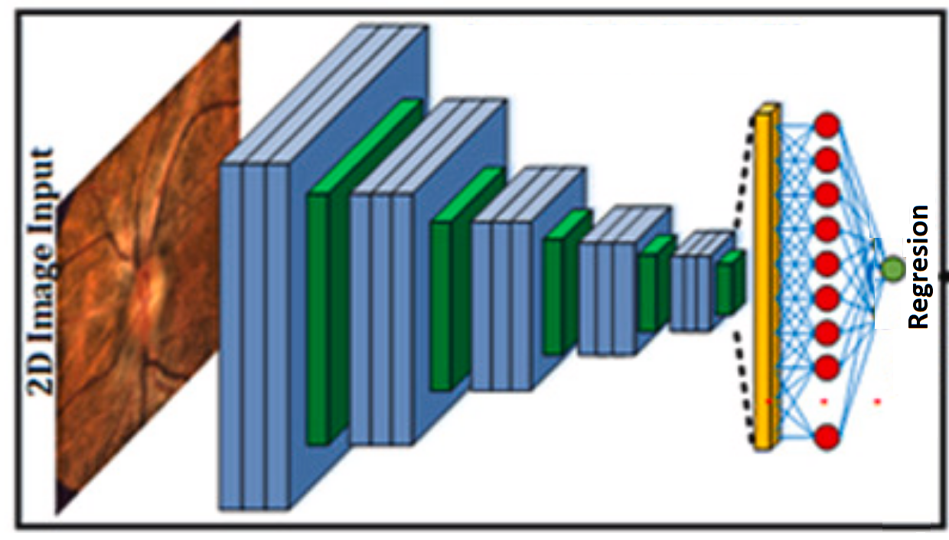


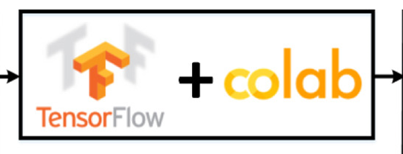
Data flow and processing
(according original code)
Colab TPU’s
Google Storage
Model Iteration
Evaluation
Train folder (1.5GB)
70,000 images (*.jpg) and labels (*.json)
train.tfrecords (29GB)
x= 70,000 binary images y= labels
Model
*.h5
Test folder (0.9GB)
44,000 images (*.jpg) and labels (*.json)
val.tfrecords (22GB)
x= 44,000 binary images y= labels

Slide 3


Data flow and processing
(modified to test the code)
Colab CPU’s
Laptop
Google drive
Model Iteration
Evaluation
Train folder (189MB)
10,000 images (*.jpg) and labels (*.json)
train.tfrecords (1.2GB)
x= 10,000 binary images y= labels
Model
*.h5
Test folder (65MB)
4,000 images (*.jpg) and labels (*.json)
val.tfrecords (0.5GB)
x= 4,000 binary images y= labels

Slide 4
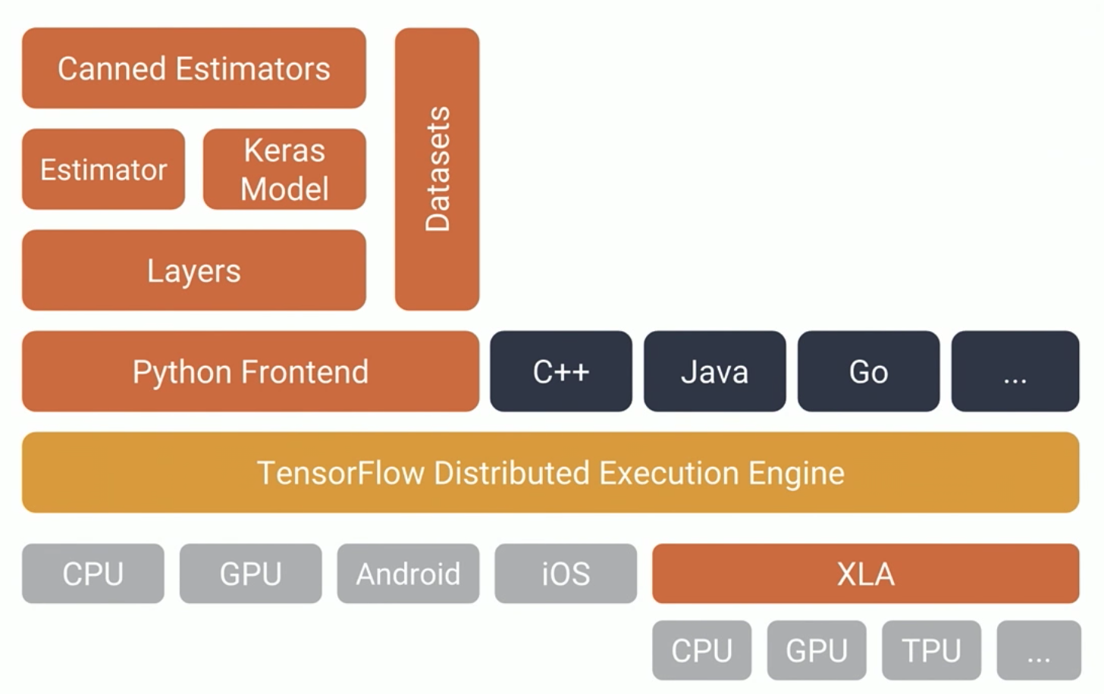
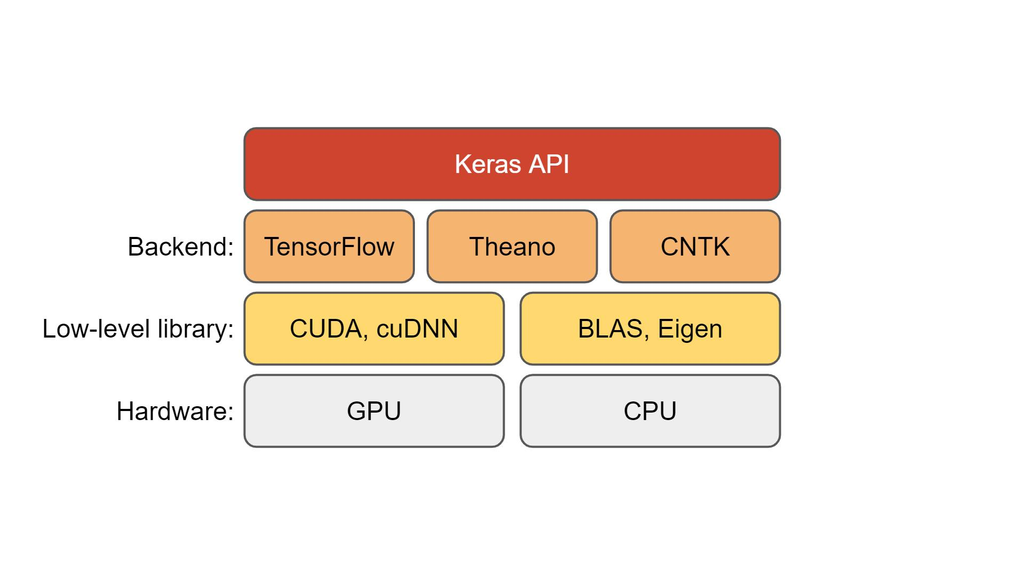
Keras
Keras is an open-source library to enable fast neural networks experimentation [9].
Provides : neural networks layers, activation functions and optimizers.

Slide 5
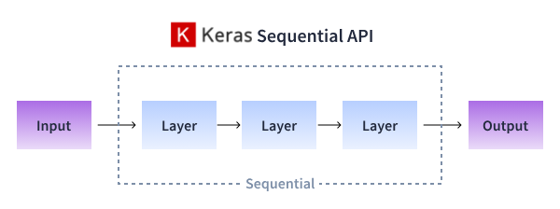
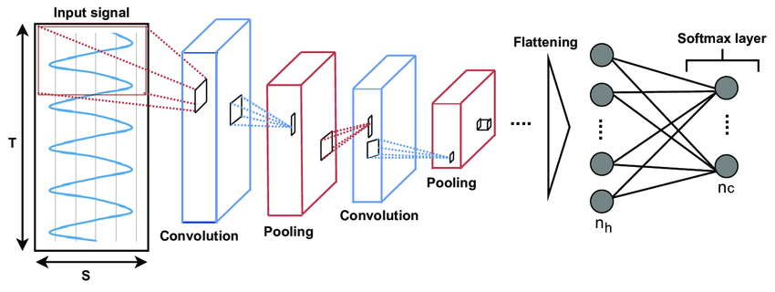
Keras layers

Slide 6
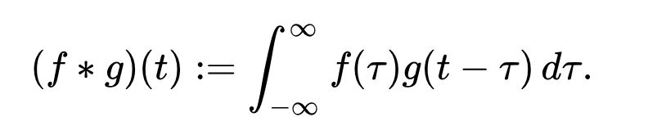


Convolution layer
Continuous time convolution
Discrete convolution
Sharp Kernel→
Output
Sharpened Image
Image

Slide 7
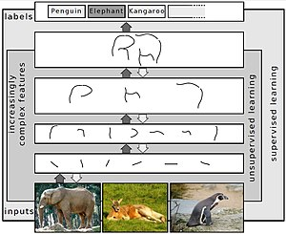
Convolution layer

Slide 8
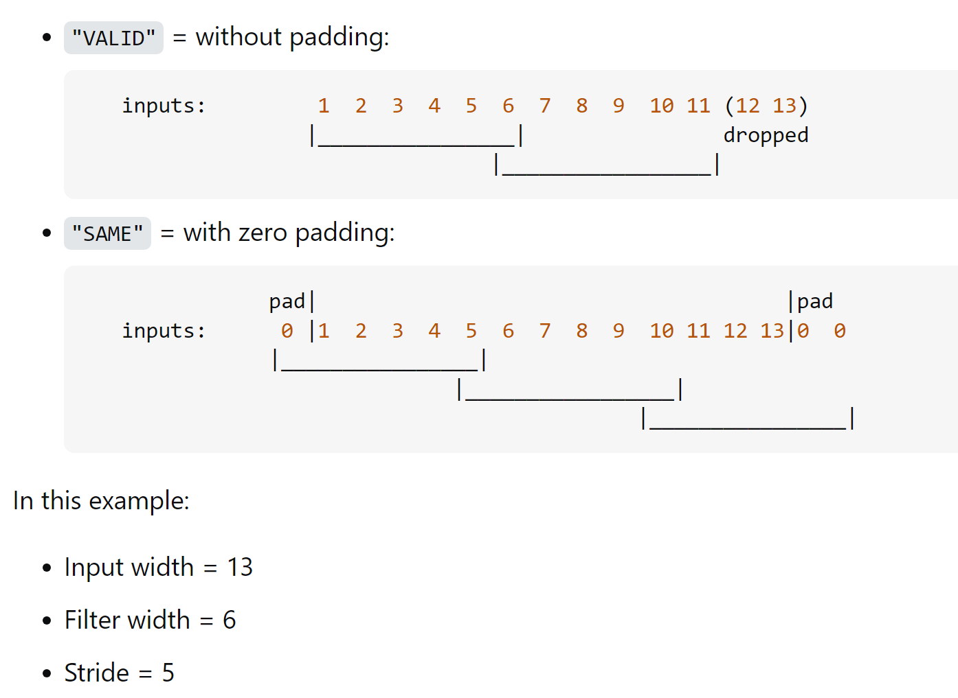
Convolution layer
model.add(Conv2D(32, (7,7), padding='same', activation='selu', input_shape=(IMG_SIZE, IMG_SIZE, 1)))

Slide 9
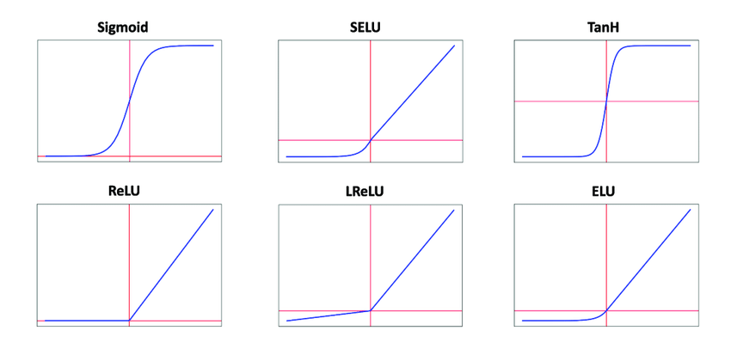
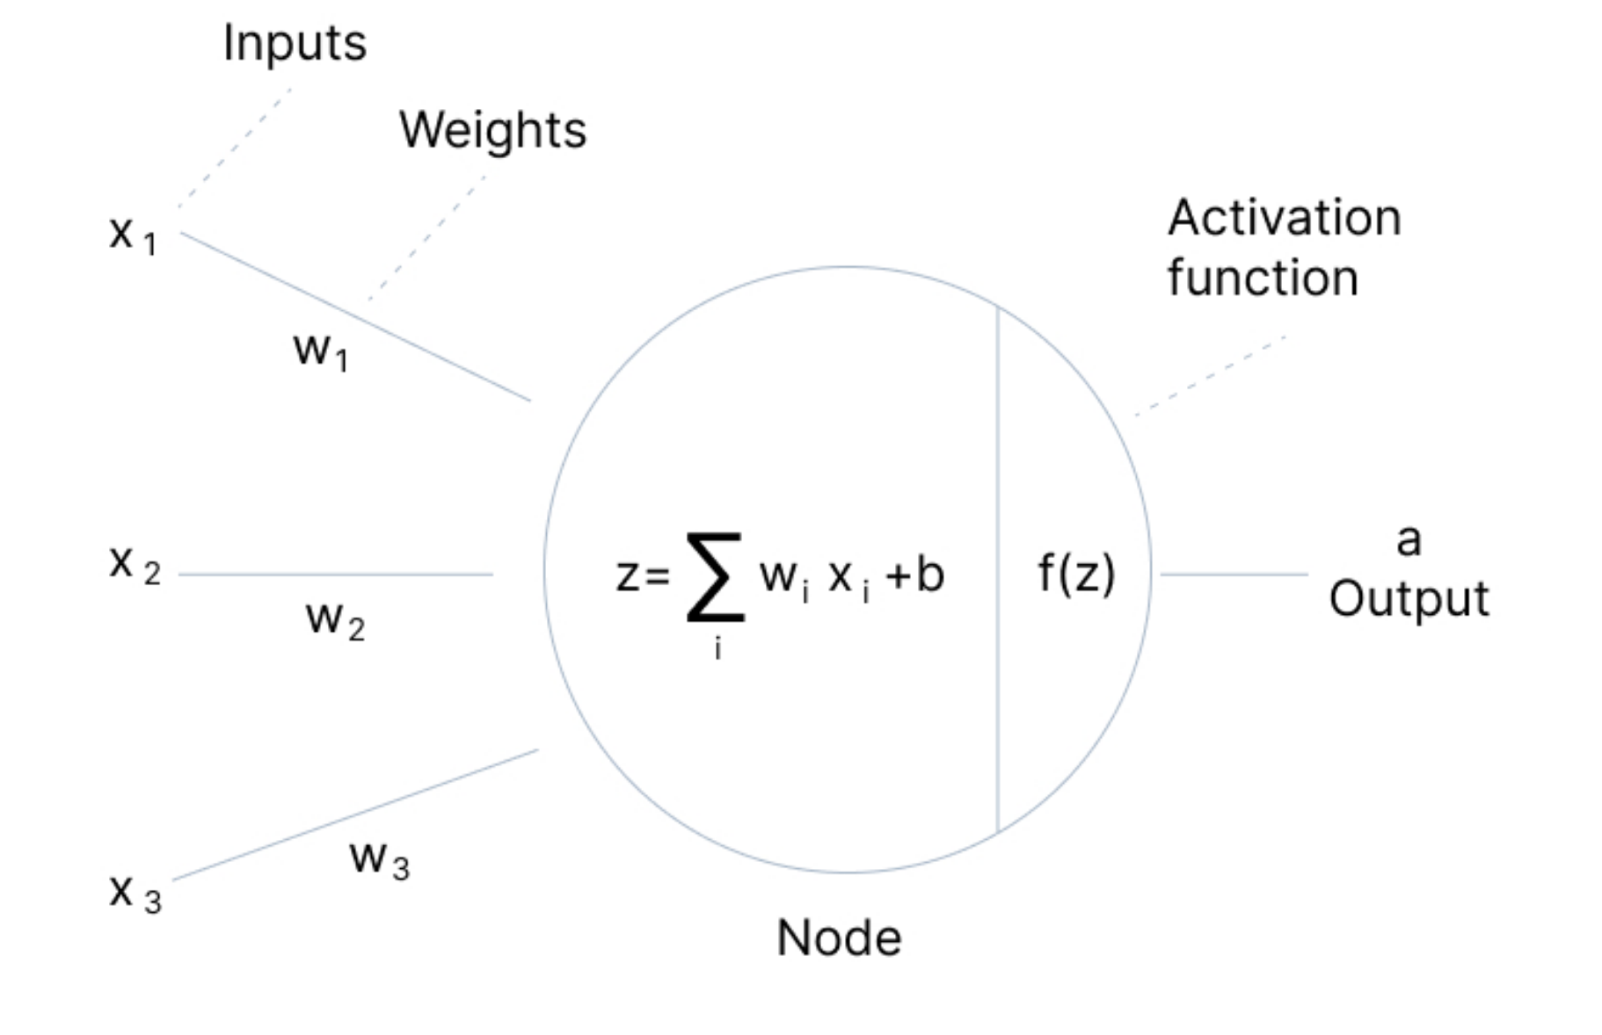
Convolution layer
model.add(Conv2D(32, (7,7), padding='same', activation='selu', input_shape=(IMG_SIZE, IMG_SIZE, 1)))

Slide 10
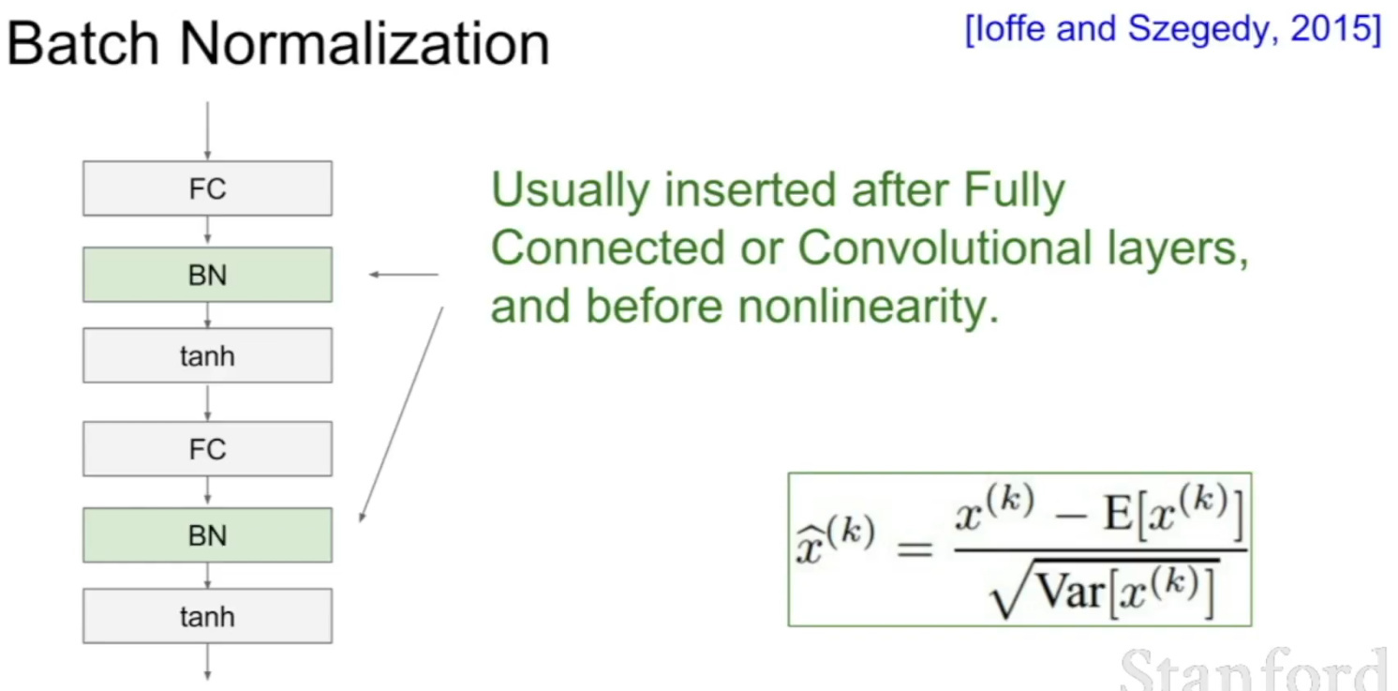
Batch normalization layer
model.add(BatchNormalization())
Batch normalization is a method used to make training of artificial neural networks faster and more stable reducing the effect of randomness in the parameter initialization and the randomness in the input data.

Slide 11
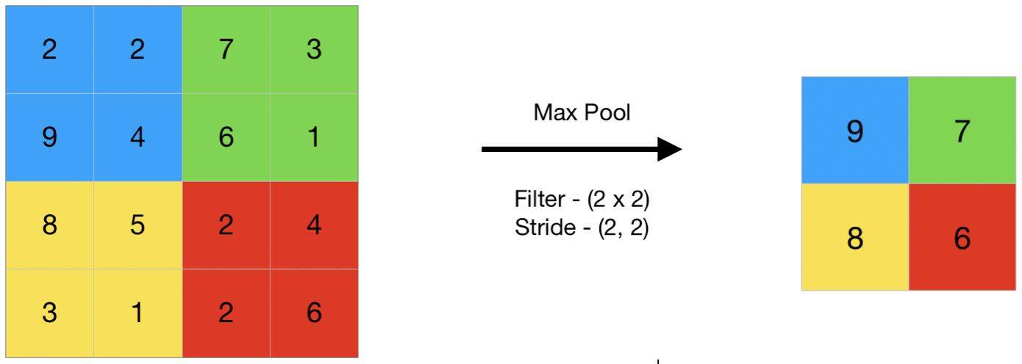
Max Pool layer
model.add(MaxPooling2D(pool_size=(2,2)))

Slide 12
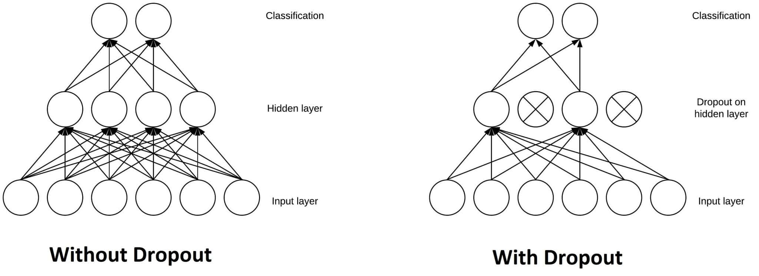
Dropout layer
model.add(Dropout(0.1))
Dropout layers prevent overfitting on the training data. If they aren’t present, the first batch of training samples influences the learning in a disproportionately high manner.
Dropout randomly deactivates some neurons of a layer, thus nullifying their contribution to the output.

Slide 13
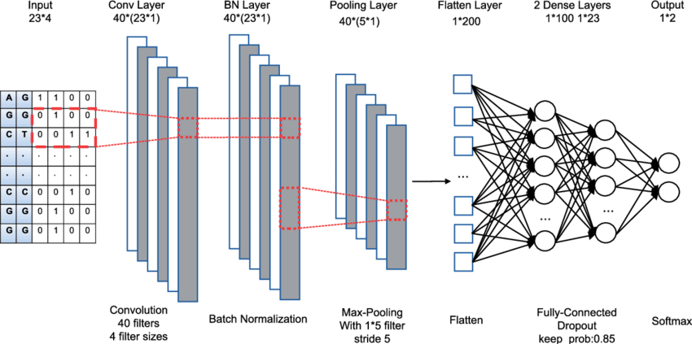
Flaten layer
model.add(Flatten())
It acts as a bridge between the convolutional/pooling layers, which extract spatial features, and the fully connected layers, which perform classification or regression tasks.

Slide 14
Dense layer
model.add(Dense(32, activation='selu'))
model.add(Dense(1, activation='linear'))
The dense layer is a simple Layer of neurons in which each neuron receives input from all the neurons of the previous layer, thus called a dense or fully-connected layer.

Slide 15
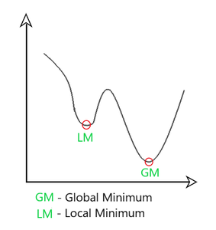
Model Compile
model.compile(loss='mse', optimizer='adam', metrics=['mse', 'mae', 'mape'])
ADAM : Adaptive Moment Estimation is an algorithm for optimization techniques for gradient descent. It requires less memory and is efficient.
Mean Squared Error (MSE), Mean Absolute Error (MAE), and Mean Absolute Percentage Error (MAPE) are metrics used to evaluate a Regression Model

Slide 16
Code flow diagram
Google user authentication
Import numpy, keras, and tensorflow
TPU setup
Train and validation dataset creation
Test data access
Data batching (subdivisions to work in parallel)
Model creation
Model fitting and validation
Model prediction

Slide 17
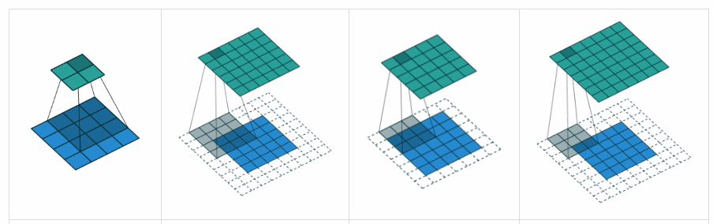

Slide 18
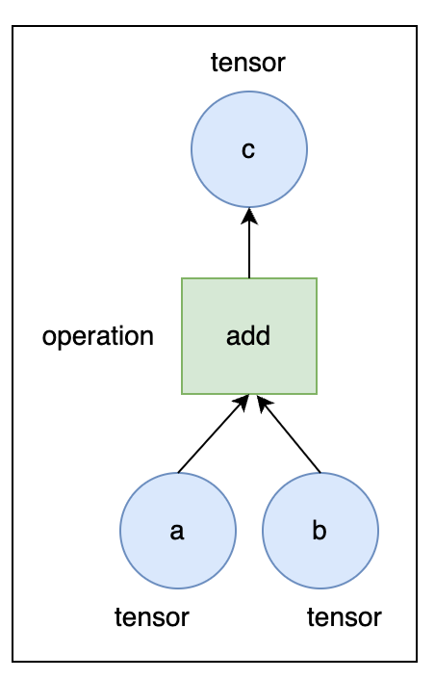
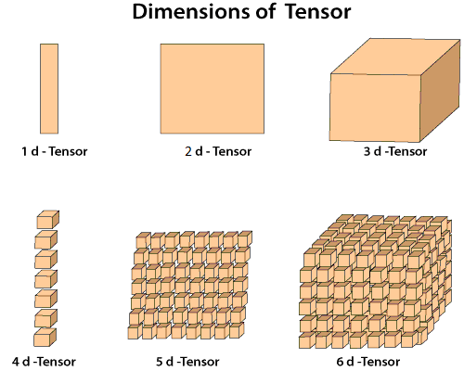
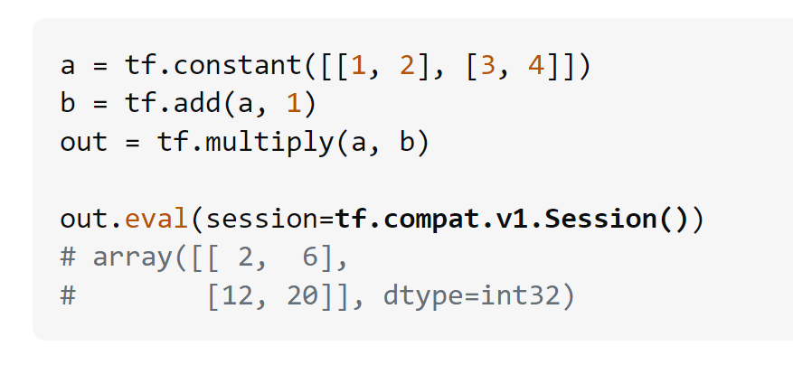
Tensor + computational graph = Tensor flow
out
mult
b
1

